Slide 1

E-Commerce Sales Analysis
Data-driven insights on customers and products

Slide 2
Project Objective
Objective: Analyze e-commerce sales data to uncover actionable business insights
Goals:
Identify top-performing products and categories
Understand customer behaviour (top countries, top categories, etc)

Slide 3
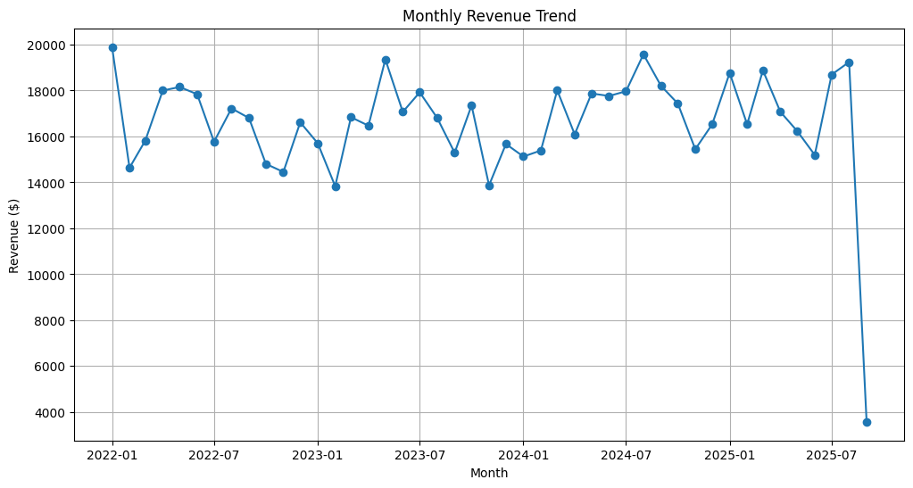
Revenue Trend
Revenue peaks during Nov-Dec steady growth overall
Business Insight: High sales during holiday season suggest that marketing campaigns and inventory planning should focus on Q4.

Slide 4
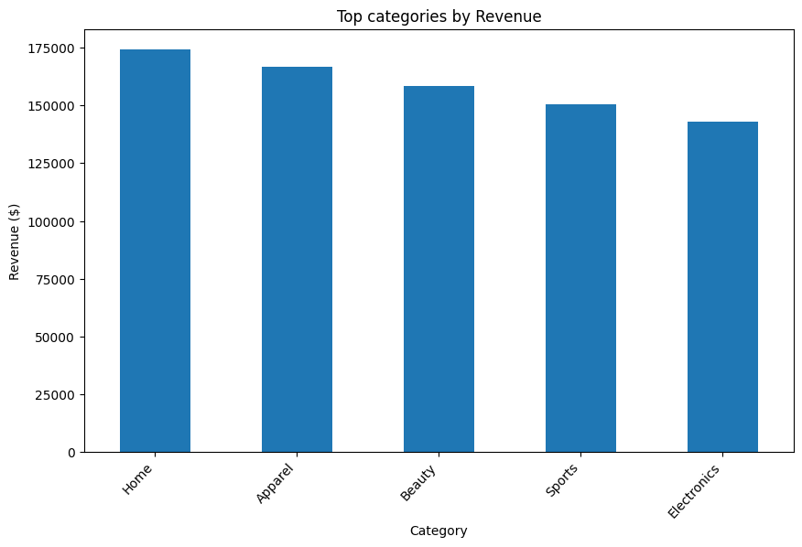
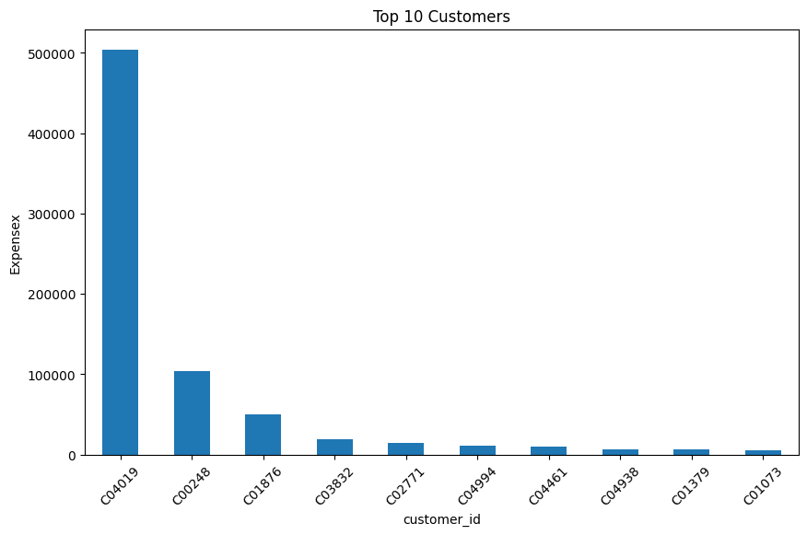
Top Categories & Top Customers
Observation: Homes and Apparel generate most revenue; top 10 customers contribute disproportionately

Slide 5
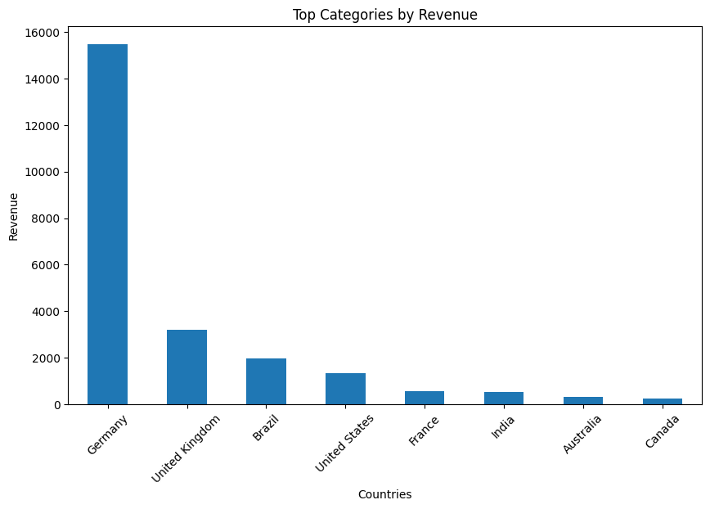
Observation: Germany and UK lead revenue; credit card and PayPal most used
Business Insight: Focus marketing efforts in top regions; ensure smooth experience for popular payment methods
Regional & Payment Insights

